Slide 1


ELEC 3040 Peer review 4

Slide 2
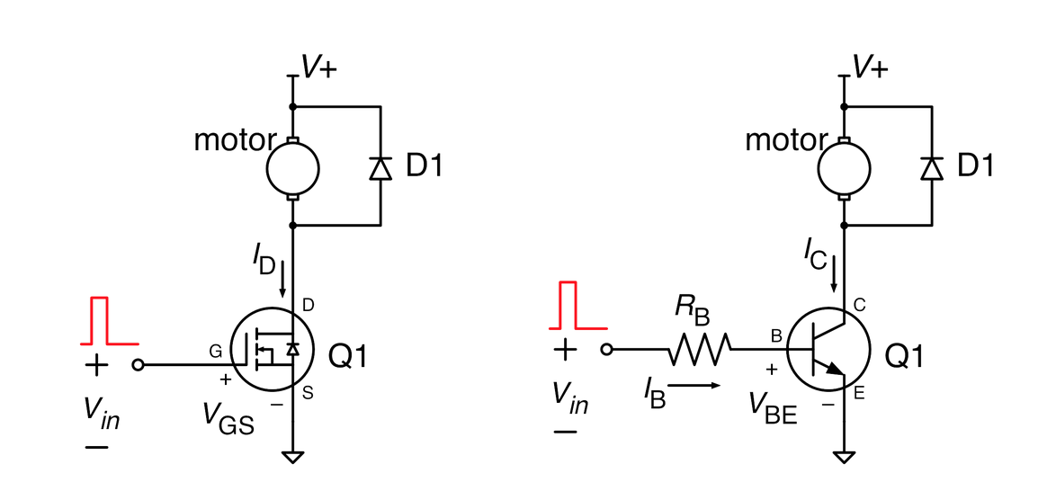
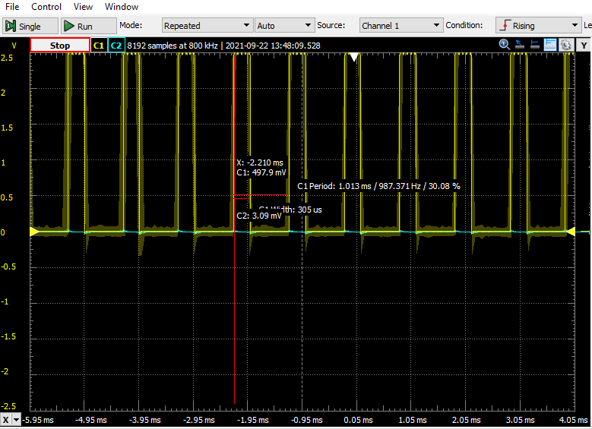
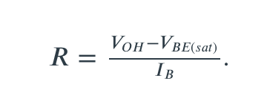
MOTOR DRIVE SPECIFICATIONS
MOSFET
BJT
Sample duty cycle image
Equation for calculation of
RB in the BJT circuit

Slide 3
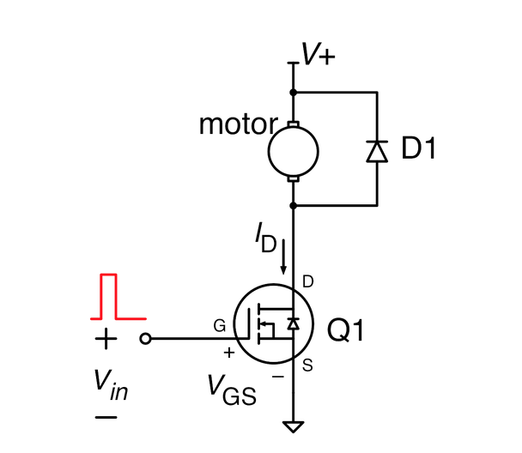
MOTOR DRIVE CIRCUIT
This circuit uses a MOSFET as Q1
Vin is the output from the microcontroller
This is equal to the duty cycle created in the C program
V+ is the 15V power supplied from the breakout board

Slide 4
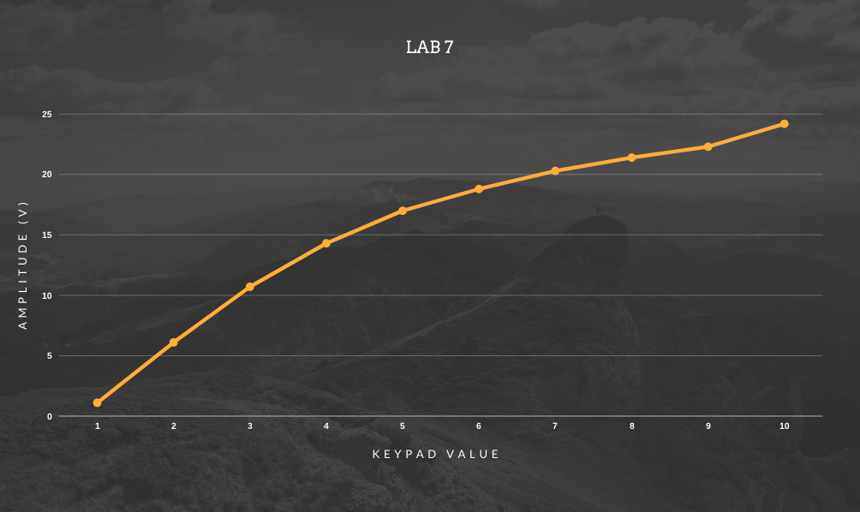
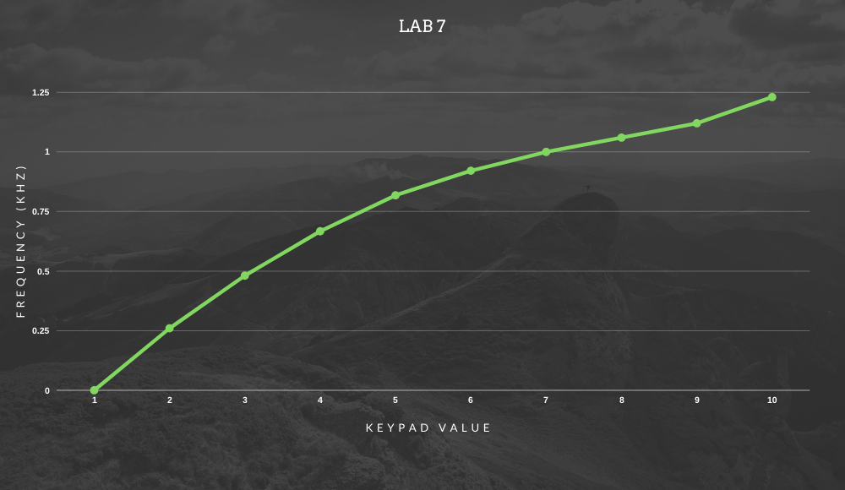
PERFORMANCE EVIDENCE
Amplitude graph
Frequency graph
Duty cycle input

